Slide 1
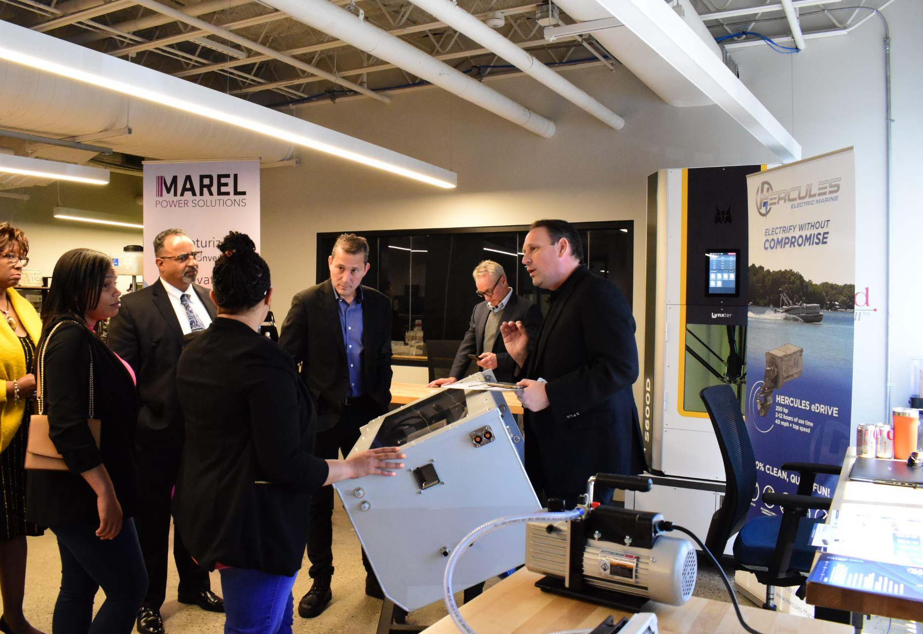
LEO Battery Supply Chain Project
January 23, 2025

Slide 2
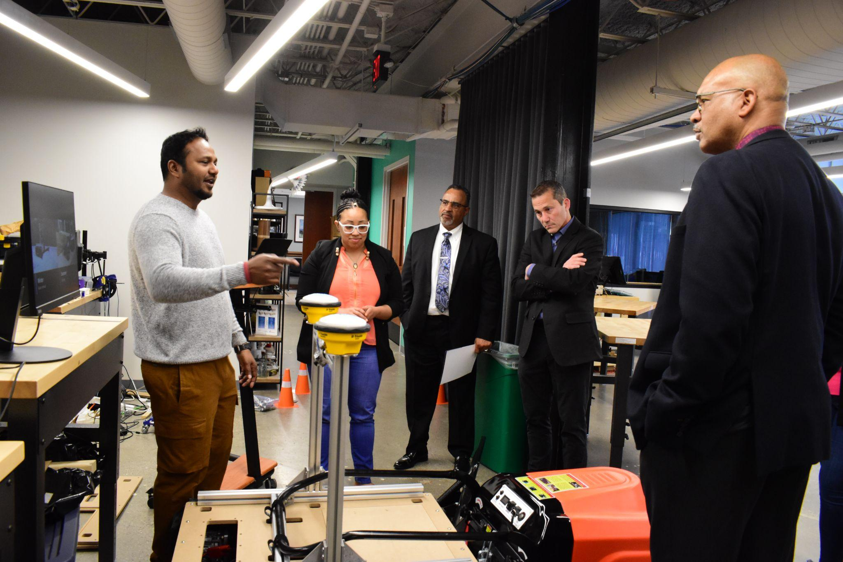
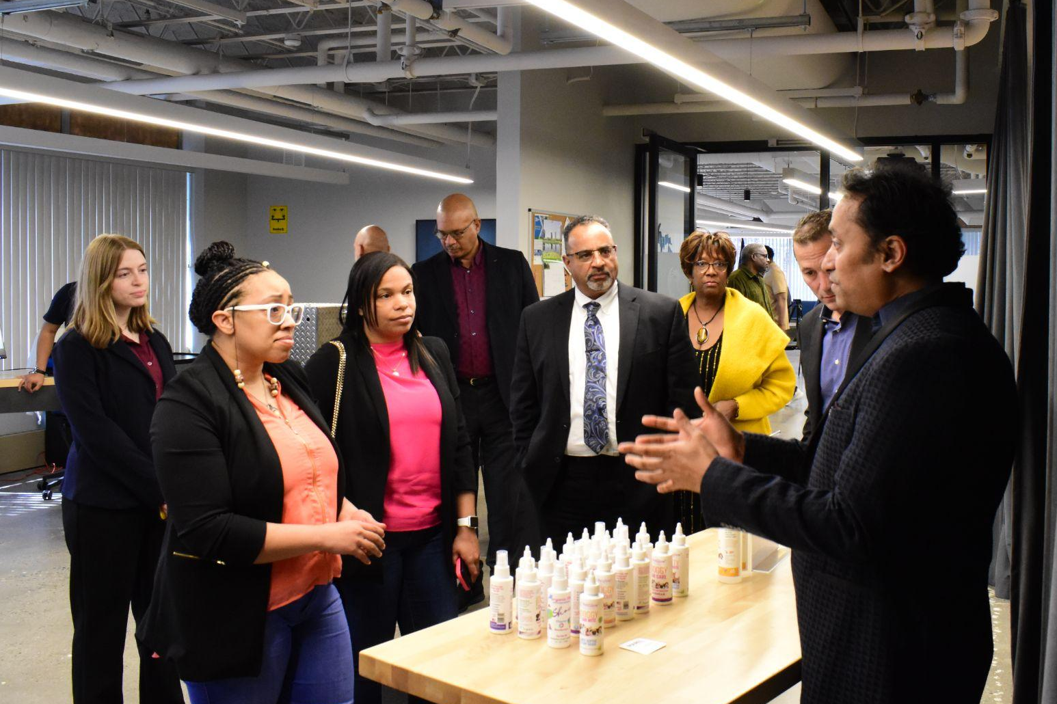

CENTREPOLIS MISSION
OUR MANTRA
To guide & support those with ideas for physical products, help them recognize their dreams, build businesses and manufacture products in Michigan!

Slide 3

The
Project

Slide 4
Executive Summary
In this report, we discuss the importance of Lithium-ion batteries and the opportunities that are present for the state of Michigan to follow through with to continue to grow the value chain
Based on interviews and survey outreach for Michigan battery companies, we compiled data in the following areas for prioritization and focus:
  Innovation priorities
  Supply Chain
  Scaling manufacturing
  Workforce development
With a SWOT analysis, the team identified opportunities and provided recommendations based on the points of focus that Michigan could consider for assisting and retaining battery companies in the state
These recommendations include:
  Enhancing industry group connectivity
  Supporting R&D collaboration and funding between industry and academia
  Cost share support for helping companies scale their production
  Adding workforce training for battery cell machine technicians and pack engineering
Notes:
Noah

Slide 5
Opportunity Statement
Michigan’s battery manufacturing ecosystem is evolving rapidly as firms shift from laboratory innovation toward full industrialization. The state is positioned to play a pivotal role in the national energy transition, but persistent supply-chain gaps, scaling barriers, economic challenges, and workforce shortages are limiting growth.
The collective research indicates that Michigan’s competitiveness will depend on building a cohesive, resilient ecosystem that bridges innovation, production and supply chain growth, and workforce readiness.
Current administration commitment to industrializing the nation offers opportunities to scale production of critical battery materials, components, cells, modules and packs
Department of War (DoW) expenditures will include significant investments in domestic batteries, despite Department of Energy (DoE) investments being reduced
Significant interest has been expressed to develop new battery chemistries that are less reliant on chinese battery materials (cobalt, nickel, graphite)
Notes:
Noah

Slide 6
Key Takeaways from the Data Collection
Limited domestic supply chain
Companies desire a more local supply chain, at the moment this is very difficult
Conditions with investments are certainly slowing down desires for scaling up manufacturing
Additionally, scale up manufacturing is a multi year process, can be impacted by numerous factors (administration priorities, consumer demand, workforce and talent gaps)
Battery area is a highly technical field that has consistent talent gaps, causing competition with each other for retaining talent
Partnerships with higher education institutes and community colleges are critical to expanding the interest and knowledge of battery development and manufacturing
Tariffs and trade policies add uncertainties that are costly especially to smaller manufacturers
Fluctuating demand has a big impact that causes delays to commitments of larger scale manufacturing
Michigan and domestic supply chain companies are having a hard time competing with China and low cost countries even with tariffs in play
Notes:
Noah

Slide 7
State of Michigan- Battery Wins
Four DoE projects will receive $355 million in federal funding* to boost domestic production of advanced batteries and battery materials and reduce dependence on foreign suppliers
  500 permanent jobs in Van Buren Township of Wayne County, as well as Flint and Muskegon. In the UP, retention of 425 jobs and supporting 1435 construction jobs
    $145 Million for Revex Technologies partnership with Eagle Mine in the UP, with a battery recycling/grinding facility in Midland
    $100 Million for Mitra-Chem to build a plant in Muskegon to accelerate scale up of iron-based cathodes
    $60 Million for NanoGraf Corp. to retrofit a Flint factory to produce enough silicon anode material to supply 1.5 million EVs a year
    $50 Million for Cabot Corp. plant opening in Van Buren, will be the first production scale facility in the US to make battery-grade carbon nanotubes and conductive additive dispersions to support the domestic supply chain (may include cells as well)
$14 billion in EV investments* committed by companies like Ford (BlueOval City/Battery Park) and LG Energy Solutions
* there is still uncertainty on the status of some projects moving forward due to changes in the administration & policies
Notes:
DAN RADOMSKI

Slide 8
State of Michigan- Battery Casualties
Several Michigan based companies have even recently seen turndown in their business plans and manufacturing footprint in the State of Michigan. Some that have announced plans recently to scale back, move or terminate production operations in Michigan include:
  Fortescue- Module & pack plant (Detroit)
  Envergia- Battery recycling (Detroit)
  XALT-Freudenberg e-Power Systems- Battery cell/module/pack (Midland+Auburn Hills)
  Natron Energy- Sodium ion battery production (Holland)
  Samsung- xEV battery pack (Auburn Hills)
Large automotive companies like GM, Ford, and Stellantis have seen an impact in business plans due to decreased demand for the EV market
  GM reported laying off about 1,700 employees from Michigan and Ohio combined, Stellantis laid off more than 1,000 employees in October at the Warren Plant in Detroit demand for EVs decrease
  SK On and Ford Motor partnership ending joint venture for joint battery factories in US to do an overhaul on business growth areas
  Ford announcing $19.6B write off including stopping build of F150 Lightning EV
Notes:
DAN RADOMSKI

Slide 9
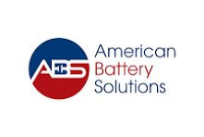
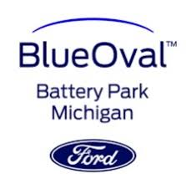



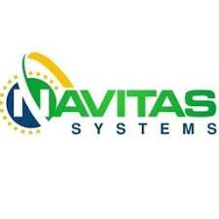





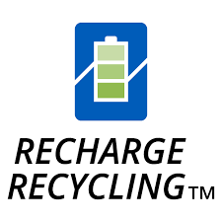


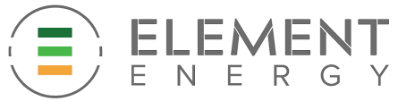

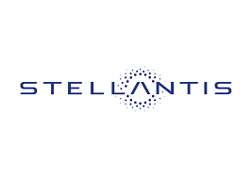

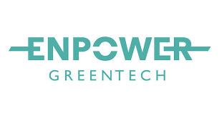





Participated Companies

Slide 10
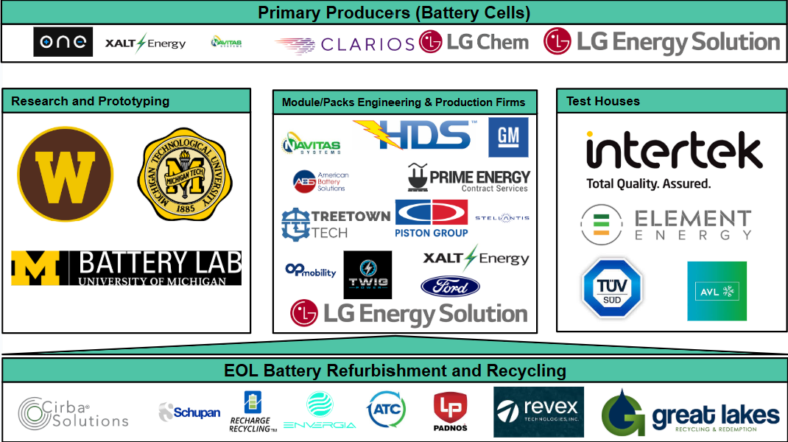
Key battery assets

Slide 11
SWOT ANALYSIS

Slide 12
Battery Supply Chain High Value Areas
High Value Supply Chain opportunities are determined by 1 or more of the 4 conditions being present:
  High price or premium cost for material, component or sub systems
  Limited number of global or domestic suppliers
  Long lead times present for material, component or sub systems
  Material, component or sub systems I being targeted by industry as a critical innovation focus are of the supply chain to improve the product performance, reliability, cost reduction, etc
Legend:
= High Value
= Low Value

Slide 13
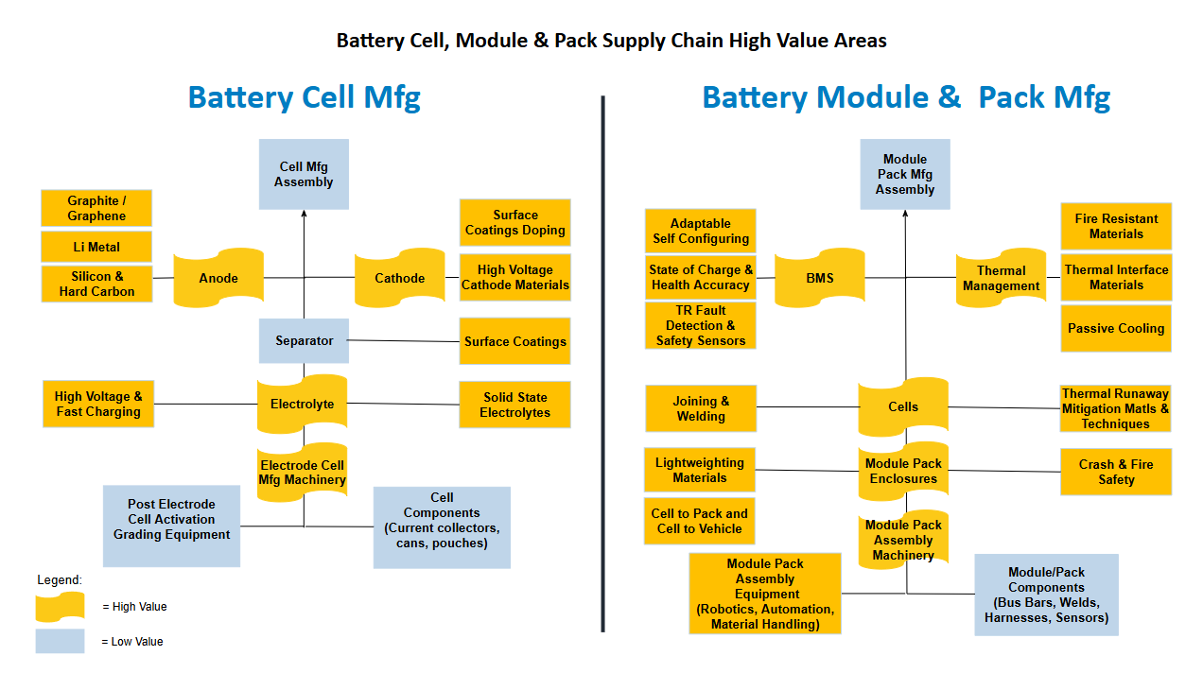
Battery Supply Chain High Value Areas

Slide 14
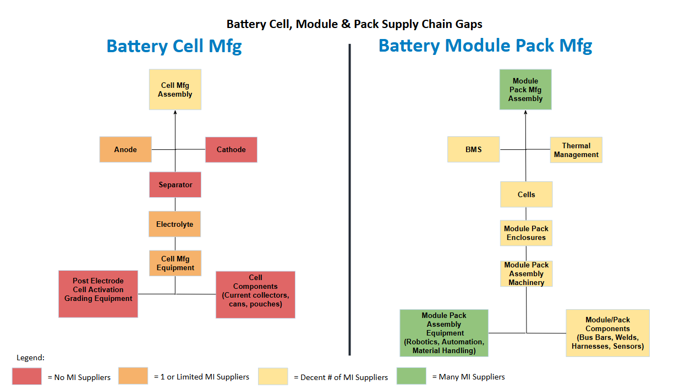
Michigan Battery Supply Chain Gaps & Opportunities

Slide 15
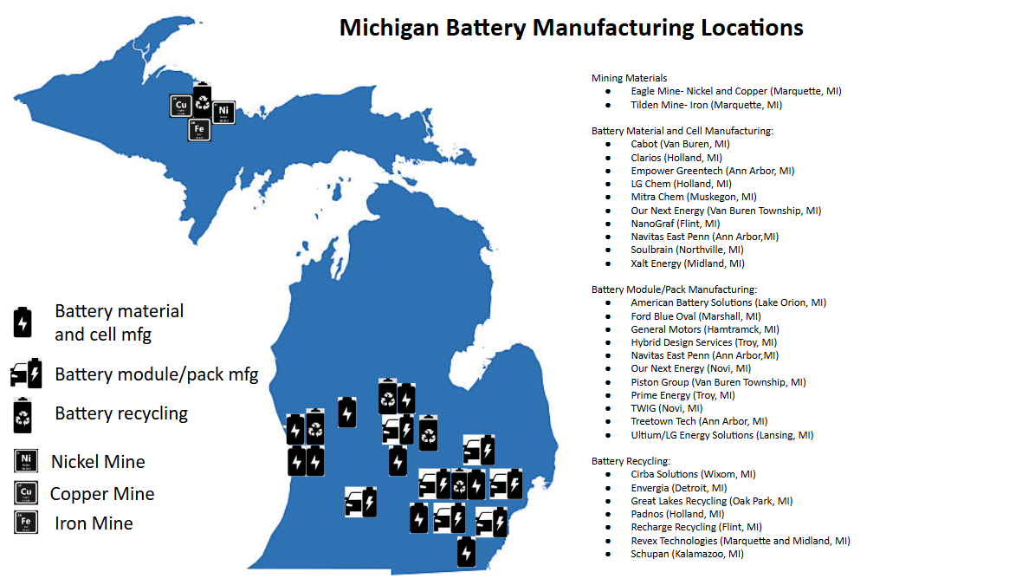
Michigan Battery Supply Chain Asset Map

Slide 16
Recommendations for Workforce Development
Review of battery training and expand if appropriate to ensure that curriculums are tailored to industry needs
  Description: Expansion or funding of existing programs that are specifically tailored to teach students specific needs and skills necessary for battery industry.
  Example Actions:
    Evaluate existing MI battery workforce development programs to gage effectiveness to consider scaling the most utilized and effective programs. Consider LEO support to expand and grow existing programs that have proven to be effective. Examples include Industry led programs like Stellantis/Oakland U Battery Engineering program, UMich EV Center. Also make sure all MI battery supply chain is aware of programs to feed in trainees and create opportunities for them as they graduate from programs. MI Battery Consortium could support this if created.
  Description: Skilled trades and specific areas identified from interviews: 1. Battery cell machine operating tech training and 2. Battery module pack engineering training, to support build and operation of new battery manufacturing facilities.
  Example Actions:
    Expand technician and skilled trade level job training programs as part of the EV jobs academy. Consider seeding UM Battery Lab that already has battery cell production equipment to provide the training.
    Better link Michigan up with broader industry activities to define battery workforce training (DoW and DoE funded as well as NAATBatt trade association led work).
    Jobs career path in battery industry being developed: https://criticalmaterials.careerpathplatform.com/map/, https://battery.careerpathplatform.com/map/

Slide 17
Verbatim statements from companies interviewed (1 of 4)
“The whole area of permitting for new manufacturing is potentially going to be a bottleneck as we go down the road, so getting ahead of that before it becomes an issue is probably important.”
“...when it comes to large scale grid storage applications…those are projects that we should work on together. We've had conversations with MEDC is…we got to push, you know, DTE or consumers energy, that whatever the utility regime is here and put some batteries with that are made in Michigan for grid storage, and then that would be a win-win, and the State can have a showcase of applications as well as manufacturing. So I think there's some opportunities like that that we can work on. Obviously, there's a lot more applications, and the grid and utility commissions in different States are probably even more active than they are in the State of Michigan.”
“If you look at equipment sourcing, China is still the fastest and cheapest option — about a four-month lead time and roughly half the cost. Korea sits in the middle, with around a one-year lead time and pricing somewhere between China and Japan. Japan is the slowest and most expensive, closer to a two-year lead time and about double the cost of Korea.”

Slide 18
Verbatim statements from companies interviewed (2 of 4)
“Every chemical right now is under threat. For the U.S, though, because of ethane supply, we have a great opportunity to maintain competitiveness on the petrochemical side. Oil refining is the same thing…when you look here on equipment, I could go to China and get equipment done. Basically, for probably one quarter of the price that we're going to pay and a delivery time of about 1 quarter.”
“We have a supplier who's willing to get us current collector pretty much on demand which is great at the size that we need custom slit perfect. But to get it here from South Korea, the cheapest we've found is $6,000 every time we ship current collector. That's a lot of shipping charges, and that doesn't include tariffs and import taxes. So you know, if if it costs $5 a meter for copper, we're then adding on tariffs and taxes and shipping that we wouldn't need to add on quite so badly or quite so much if it were domestic.”

Slide 19
Verbatim statements from companies interviewed (3 of 4)
“...think that the industry is right for having a really hardcore industry wide attack at trying to define these powders in a way that both allows companies like us to get what we want…it'll allow the innovative companies who are developing new powders and manufacturing processes to define why theirs is better right now. All they can do is say we made this new powder. It works well in this area. Here you try it and tell us what you think they can't say.
“ in the beginning, we did apply for some, for some grants, I guess I would say, that came out. And then, after that, we, that kind of fell to the wayside, and part of what we saw was that there were a lot of, there were some hurdles, right, with those… with those thoughts, either timing or, specific areas that we needed to utilize the funds in.”
“We see a lot of need for people ask us all the time. Do you have a BMS? There seems to be a not great battery management system ecosystem out there. A lot of custom bespoke kind of one off, but not quite with the full development time that's needed feels like there's a space and a market for developing a kind of core set of some of the electronics that could be reused in different ways…”

Slide 20
Verbatim statements from companies interviewed (4 of 4)
“Because what happens in an industry that is growing and there's limited talent in certain areas is a lot of poaching happens and then talent acquisition becomes very high for a company… you talk about the the engineering disciplines. It doesn't matter if it's mechanical electrical systems software. Those are probably the big ones that ties into the BMS, those are the big ones right now, and they will probably always be like that.”
“And then we can train them on that part for people who have either worked for a couple of years in a cell manufacturing environment or had, you know, other experience with lithium production, manufacturing, especially equipment, related experience. It'll be all very helpful. I don't know where to find these people in Michigan.”
“... think Michigan is actually one of the few places that does have that talent, and it's actually one of the reasons we chose Michigan in the first place. The workforce development options we have, the relationships we built with Mott Community College and Kettering University. Made us feel much better about our… our ability to hire good talent for the facility, so…I think it was actually one of the strongest things about Michigan.”

Slide 21
Interview & Survey Participating Companies- Thank You
American Battery Solutions
Cirba
Dukosi
Element
Enpower Greentech
Envergia
Ford BlueOval
Forward Engineering
Hybrid Design Services
Intecells
Intertek
LG Chem
University of Michigan
NanoGraf
Navitas
Our Next Energy
Padnos
Piston Group
Prime Energy
Recharge Recycling
Revex Technologies
Stellantis
TreeTown Tech
TUV
UM Battery Labs

Slide 22
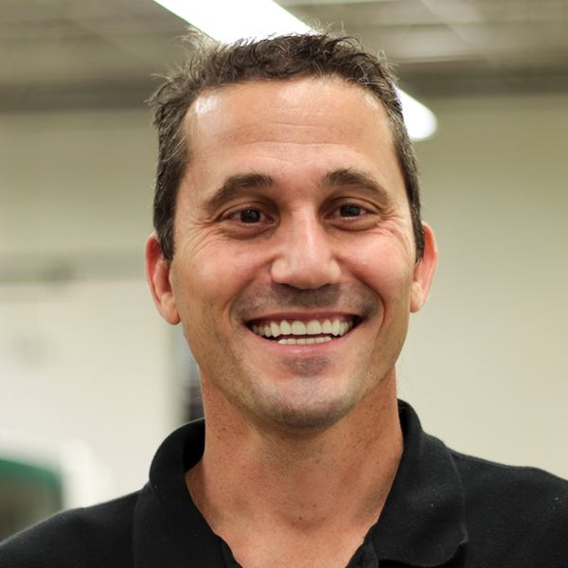
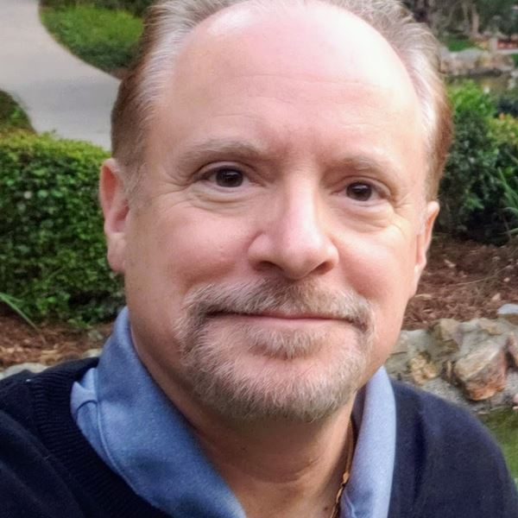


AUTHORS
Daniel Radomski is the Chief Executive Officer and founder of Centrepolis Accelerator. helping hardware startups and small manufacturers scale. He also advises national cleantech accelerators and DOE programs.
Joe LoGrasso is an electrification and battery consultant and founder of JL Energy Advisors LLC. He has over 30 years experience in e-mobility and battery design, dev’t and strategy. He is also an Expert in Residence at Centrepolis Accelerator on electrification projects
Pedro Guillen is COO of Centrepolis Accelerator and brings over 20 years of experience in technical and innovation consulting, supporting new product development and advanced technology deployment across the mobility, defense and advanced manufacturing sectors.
Noah Rodriguez is program manager for this project at Centrepolis Accelerator. He is a recent graduate of Lawrence Technological University with a bachelors and masters in Business Administration.

Slide 23
Dan Radomski
CEO
dradomski@ltu.edu

Slide 24
Sources
Alan K. (2024). Chart: The $400 Billion Lithium Battery Value Chain. https://elements.visualcapitalist.com/lithium-battery-value-chain/
AP News (2025). GM lays off 1,700 workers at plants in Michigan and Ohio amid slower EV demand. https://apnews.com/article/gm-layoffs-ev-battery-plants-30792ad41c5148fb5528a2d0bcc0b59b
BloombergNEF (2024). Headwinds in Largest Energy Storage Markets Won’t Deter Growth. https://about.bnef.com/insights/clean-energy/headwinds-in-largest-energy-storage-markets-wont-deter-growth/
Bruno V. (2025). Top 20 Countries by Battery Storage Capacity. https://elements.visualcapitalist.com/top-20-countries-by-battery-storage-capacity/
Camila D. (2024). Stellantis, maker of Jeep and Ram, lays off more than 1,000 Detroit workers. https://www.npr.org/2024/10/11/nx-s1-5145932/stellantis-jeep-dodge-chrysler-layoffs
CNBC (2025). South Korea’s SK On, Ford Motor to end U.S. battery joint venture. https://www.cnbc.com/2025/12/11/south-koreas-sk-on-ford-motor-to-end-us-battery-joint-venture.html
Michael Alan H. (2025). Advanced Lithium-Ion Energy Storage Battery Manufacturing in the United States. https://www.congress.gov/crs_external_products/R/PDF/R48538/R48538.6.pdf

